Slide 1
Home

Slide 2
Logo
Platform
Use Cases
Resources
Company
Contact Us
Image
Trust Orchestrator
Powering Conversational AI you can trust
Watch video

Slide 3
Home
The conversational AI challenge
The solution
What makes it unique
Notes:
I think your intro has already given the pain point and the solutions – can you consider this being a ‘Solutions we offer’ or “Options we offer’ page?

Slide 4
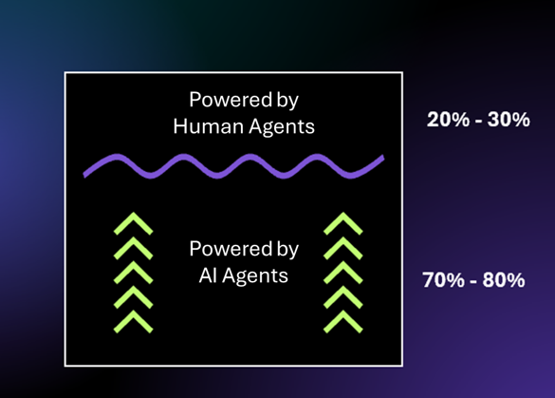
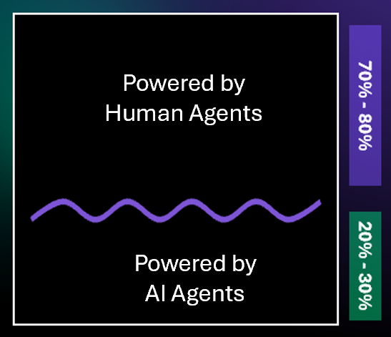
Home
The challenge we solve
Automating the majority of CX conversations safely without relying on trained human agents being in the loop
The Digital First vision
The Digital First reality
Most companies get trapped in pilot purgatory
The last mile is proving costly and is taking longer than expected
Beyond FAQs and basic requests, AI-first chatbots, assistants and agents struggle to automate contextually-rich, rule-bound conversations
There is still a high reliance on ‘live’ human agents to handle digital conversations
More on the challenge

Slide 5
Home
The solution we offer
A Conversation Orchestrator that can automate >80% of your rule-bound conversations in line with enterprise requirements
Trust Orchestrator is designed to help regulated companies significantly increase the percentage of conversations that are automated unassisted. Our unique logic models make expert-level engagements possible, at scale.
Offer customers immediate, expert-level support, 24/7 no matter the channel
Automate the majority of CX conversations, without relying on human agents
Liberate human agents to focus on the lower volume, higher value calls
Reduce the cost and compliance risk of multi-channel self-service
More on the solution

Slide 6
Home
What makes Trust Orchestrator unique?
Unlike AI-first Conversation Orchestrators, Trust Orchestrator is deterministic first, probabilistic second by design. Our unique approach to conversational logic delivers a powerful blend of fluency and control, assistance and expertise, flexibility and structure.
Expert level conversations
Minimal transfers to human agents
Full control over context-rich conversation flows
Rich, detailed reporting and analytics
Feature | Benefit
Expert-level logic capable of automating any known rule-bound conversation, completely unassisted | You can maximise the range and volume of fully automated conversations and free staff to focus on higher value calls
Every conversation is rule-driven yet dynamically shapes to data (provided from customers, LLMs or systems) | You can trust your Conversational AI Agent to follow your rules while adapting to your customer’s context (no brittle, decision tree hell)
Conversations are engineered with full transparency and auditability | You can trust that the right things will always be said and done, irrespective of context, with full reporting to prove it
Conversations can flow between different AI and human agents, languages, channels and time periods | You can ensure every conversation gets completed even if it takes different forms at different times (keeps state)
Next responses and actions are controlled through targeted context prompt engineering | You can trust that what gets said and done is based on your rules applied to the full context.
Low/no code modules allow internal teams to architect and control conversations across channels and systems | You don’t need to worry about depending on expensive consultants to realise your Digital First strategy
More on that special something

Slide 7
Home – The Conversational AI challenge
The hard truth about CX automation in regulated companies
Most find themselves trapped in pilot purgatory
42% of AI initiatives scrapped before production
46% of AI pilots killed midstream
65% of firms don’t scale AI across departments
95% of GenAI pilots yield no business impact or tangible P&L outcomes
Almost none deliver AI decision-making power at scale

Slide 8
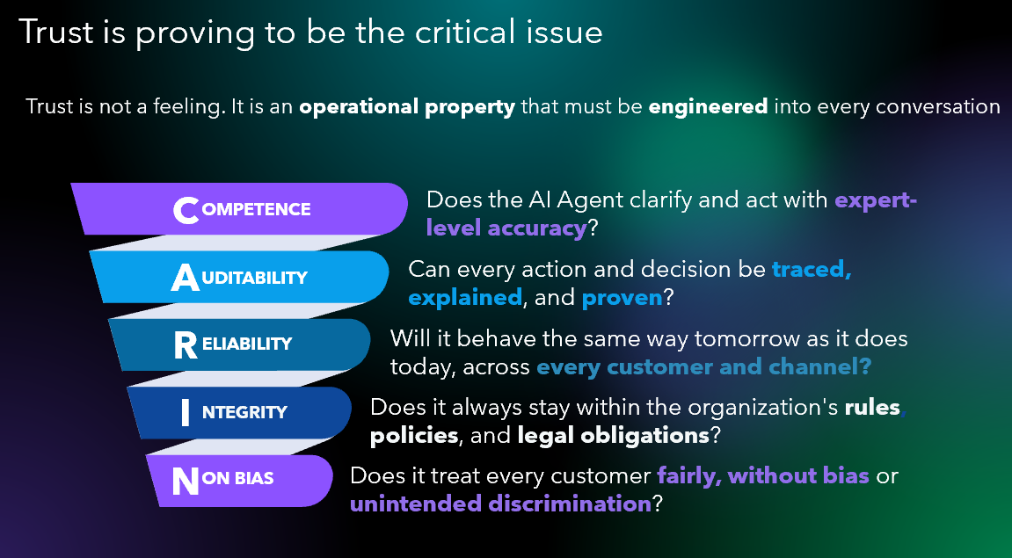
Home – The Conversational AI challenge
Source: Carin framework

Slide 9
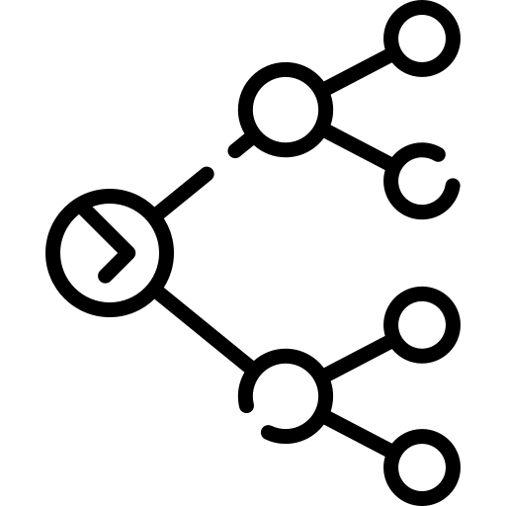



Home – The Conversational AI challenge
Few orchestration platforms are architected for trust
Conversational Orchestrators designed off an AI-first architecture power self-reasoning and self-learning AI Agents. These tend to perform well in unstructured and unregulated environments. They don’t perform well in environments where conversations must be trusted to follow prescribed rules and processes and to reach consistent, compliant and accurate outcomes.
Probabilistic AI can’t assure required accuracy and transparency
Decision trees collapse under complexity
Compliance failures = high financial and reputational exposure
Customers zig-zag: change topics, sentiment, break scripts
Notes:
Start with a move conversational tone …. Historically, usually
Compliance failures often result in high financial costs and ….

Slide 10
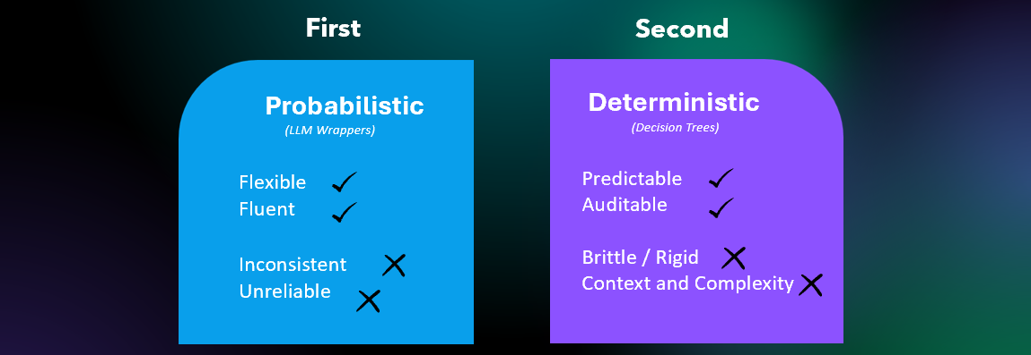
Home – The Conversational AI challenge
A key limitation comes from the underlying models
By adopting a Probabilistic first – Deterministic second approach, Conversational AI Orchestrators rely on predictions to determine what to say or do next. And predictions are not always accurate, especially when rules matter and context is missing.
In process-heavy conversations, decision tree flows become brittle as complexity increases. They can’t reflect the many directions that get taken in every conversation. Situations vary. Pathways change based on each customer’s context. Its hard to predict every possible response. And its even harder to maintain logic at scale. As a result, human agents must be architected into every conversation to act as a fail safe for when AI Agent logic fails and customer frustration boils over.

Slide 11
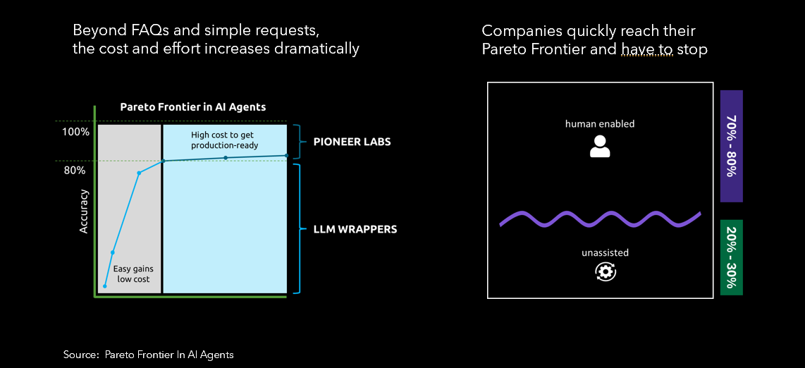
Home – The Conversational AI challenge
The high cost of automating trusted conversations
In regulated industries, 80% accuracy is not good enough. It must be closer to 100% for responses and process compliance. Yet the probabilistic nature of most AI Agents means that the cost to complete ‘the last mile’ is high. And so is the cost to have trained staff available 24/7 to take over when the logic fails.
Powered by Human Agents
Powered by AI Agents
Notes:
Is Pareto frontier a familiar term for industry?

Slide 12
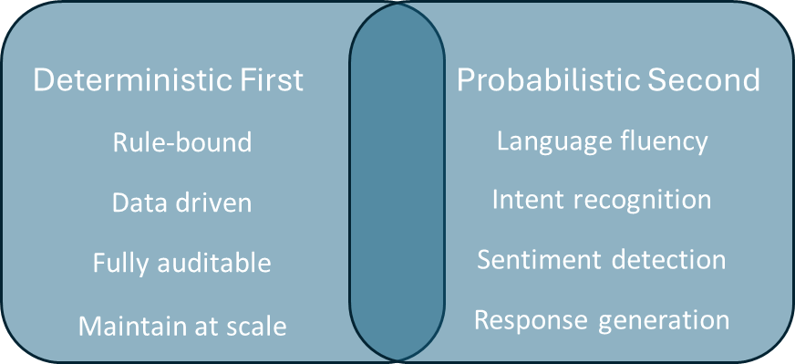
Home – The solution
Trust Orchestrator makes true Digital First possible
Trust Orchestrator is a deterministic-first, probabilistic second decisioning and orchestration platform powered by a unique approach to conversational logic engineered for both fluency and control, structure and flexibility.
It allows regulated companies to achieve a true Digital First CX reality by significantly increasing the volume of conversations that can be fully automated with less cost and risk.
View more on the logic approach

Slide 13
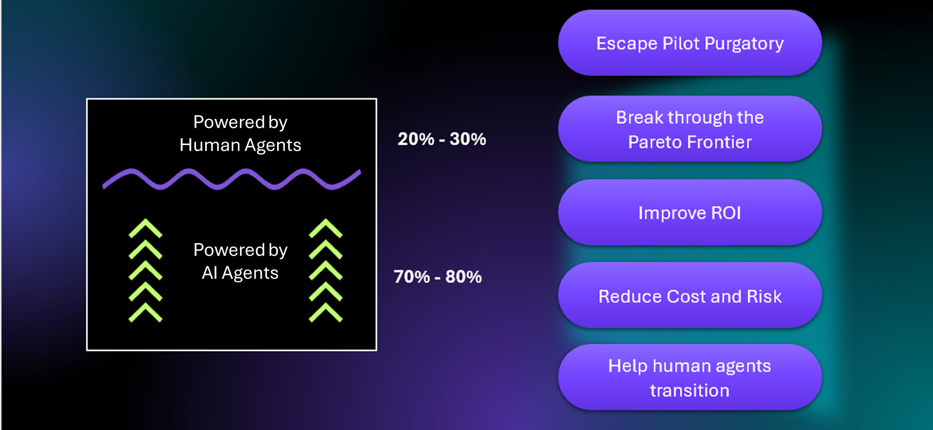
Home – The Solution
Boost your conversation automation volumes
Trust Orchestrator allows you to build Conversational AI Agents capable of automating a wider range of conversations without relying on humans in the loop. These digital experts can handle simple to highly complex rule-bound conversations completely unassisted. They don’t get stuck or confused. They just get the job done. The result is that human agents can focus on the lower volume, higher value calls.
Book a demo
Notes:
Can effectively automate

Slide 14
Home – The solution
Conversational AI Agents that are experts, not just assistants
Trust Orchestrator is designed to power expert-level conversations. They are not simple assistants. In any conversation, our Conversational AI Agents can:
Clarify multiple intents, identify multiple goals, identify multiple signals and gather all required context before acting
Always stay within policy and compliance guardrails even when rules and context change
Offer responses, identify needs and causes, make recommendations, resolve queries and trigger required next actions all in context.
Make sure every question asked, answer given, decision taken and action triggered is tracked for audit and compliance
Script context-rich prompts and webhooks for accurate next actions in 3rd party systems and LLMs
Guide human agents safely through live calls without them needing to know the rules (policies, processes, products)
Offer detailed records of every question asked, answer given, rule applied and action taken
View full capability list
Notes:
Not simply an assistant?

Slide 15
Home – The solution
Transition staff to higher value calls
Image
Rather than architect humans into rule-bound call flows, Trust Orchestrator helps transition them out of these conversations and into higher value call types (non-rule bound).
This takes time. Conversational AI Agents need to be trained on the full scope of rule-bound conversations. They also need access to relevant systems to complete these engagements fully unassisted.
While this process is underway, certain rule-bound calls will need to be handled by humans. Customers also need time to get used to having Conversational AI Agents resolve their queries without error or engagement friction.
The transition to full automation of rule-bound conversations can take 1-3 years. To free staff from having to learn call types that will ultimately get automated, we provide a Call Navigator. Like a GPS, it guides them through live calls without relying on their product, policy or process knowledge. This frees agents to learn different call types while still being capable of handling rule-bound calls if customers prefer to speak to a human.
Book a demo

Slide 16
Home – Why it is special
Human fluency. Expert accuracy.
Image
Large language models (LLMs) power unstructured engagements with human fluency. Expert systems and rule engines power structured engagements with process accuracy. Combining the two has long been considered ‘hallowed ground’.
Trust Orchestrator has solved this challenge with an approach to conversational logic that blends the best of both, while mitigating the weaknesses in each.
Our deterministic-first, probabilistic-second design allowed us to re-imagine the outdated and rigid decision tree logic that constrains most AI Agents. The result is a data-driven logic object approach that allows rules to govern yet data to shape every conversational journey in real time.
With Trust Orchestrator, you can automate any conversation that is rule-bound, no matter how complex, with language fluency of an LLM.
Make Digital First a reality, not simply an aspiration.
Book a demo

Slide 17
Platform
Overview
Features
Channels
Modules
Architecture
Notes:
Should this not be earlier on the website

Slide 18
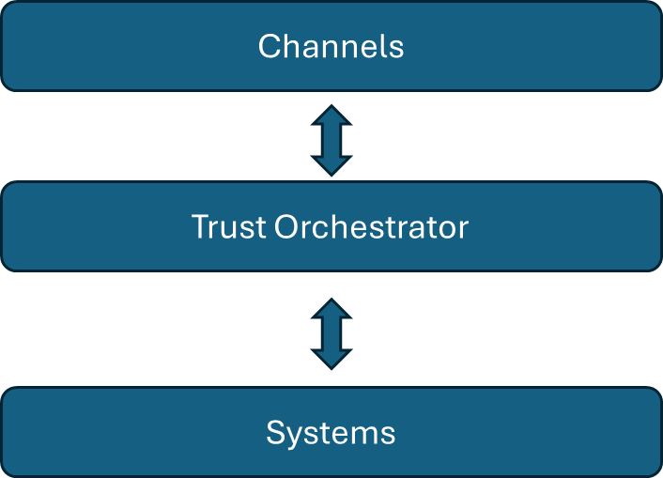
Platform – Overview
Orchestrate trusted conversations across channels and systems
Trust Orchestrator is a low/no code platform designed to orchestrate high volumes of rule-bound unassisted and assisted conversations across multiple channels and systems safety.
It connects the customer (front office) to operations (back office). And it does this in a way that you can control and automate regulated conversations at scale.
Notes:
And systems safety??

Slide 19
Platform – Overview
Conversational AI Agents that get the job done, first time
Trust Orchestrator allows you to build and deploy Conversational AI Agents capable of getting the job done, no matter the call complexity.
They are capable of a wide range of skills inclduing:
Image
Routing: Clarifying and categorising the caller’s intent before routing the engagement through to the relevant system or person to resolve
Diagnosing: Analysing the caller’s situation or set of needs and diagnosing the root cause of their problem or issue.
Questioning: Asking the questions to gather the data required for a contextually-accurate next response or action.
Answering: Responding in context of the situation, data and rules.
Actioning: Triggering the relevant systems to perform the required next action.
Processing: Talking through a specific process and dynamically adjusting to the situation, data and rules.
Tracking: Giving details of every conversation they had. Every question asked, rule applied, answer given and action taken for insights and compliance.
More on unassisted AI Agents

Slide 20
Platform – Overview
Human agents empowered to support the transition
To help human agents transition away from scripted, rule-bound conversations, Trust Orchestrator offers a Call Navigator. Its purpose is different to a Co-Pilot.
A Co-Pilot is designed to help agents more efficiently handle the rule-bound calls they are trained to handle. These are typically rule-bound, context rich calls. The Co-Pilot does this by offering prompts, generating responses or automating system actions.
A Call Navigator is designed to navigate human agents through rule-bound calls that don’t normally form part of their daily call focus (these calls get allocated to Conversational AI Agents). Human agent simply field these calls if a customer requests to talk to a human.
The Call Navigator works like a GPS. It guides the agent in real time through the call, adjusting the script based on customer responses and system data. It assumes the agent does not know the rules. They just need to follow the script.
By making it possible for a human agent to navigate a rule-bound call without prior training, the Call Navigator allows human agents to focus on their conversational skills rather than worry about business rules and compliance.
Image
More on the Call Navigator

Slide 21
Platform – Overview
The conversational logic that makes this possible
Image
Trust Orchestrator is architected to be deterministic first, probabilistic second. Our unique logic model is controlled by rule-driven logic objects rather than rigid decision trees. These objects get shaped by data (from the customer, an LLM or 3rd party system).
Rules control every engagement while data shapes it to fit the customer’s context. This allows you to automate conversations that:
Have the fluency of a human
Are directed by explicit rules, yet shaped by context (data, situations, a change in sentiment or direction).
Can reflect the diagnostic, analytic skills of an expert (not just simple FAQs and requests)
Are goal-directed and get the job done
Can flow across different channels, systems and timelines without losing state

Slide 22
Platform – Features
The key ingredients to trusted conversation automation
Trust Orchestrator is designed to maximise the range and volume of conversations a Conversational AI Agent can automate, unassisted. It does this by architecting the following into every conversation:
Rule-driven
Data-shaped
Context engineered
Every conversation stays inside policy and process rules with no risk of errors
Conversations shape to data, rules and context (not decision tree, menu driven)
Prompts and webhooks contain the context required for accuracy
Learn More
Learn More
Learn More
Diagnostics
Fluency
Auditability
First clarify, analyse and diagnose before giving an answer or taking an action
Natural language conversations with human-like fluency
Every question asked, answer given, rule applied and action taken tracked
Learn More
Learn More
Learn More

Slide 23
Platform – Features – Rule Driven
Rule Driven
Every conversation orchestrated by Trust Orchestrator is bound by rules. The platform does not support probabilistic first conversations where only predictions are used to determine the next response or action.
Data-driven logic objects containing engagement rules determine every next response or action. These rules are captured within Trust Studio and applied in context when conversations are automated with a customer (via the Trust Engine). Rules regarding access to logic and AI Agents, as well as versions and reporting also get controlled using Trust Manager.
Notes:
I think this could be an image

Slide 24
Platform – Features – Data Shaped
Data Shaped
Trust Orchestrator’s logic objects contain the rules for every conversation. To apply these rules to the specific context, data gathered from 3rd party systems, LLMs (intent, sentiment), and the responses from the customer themselves get injected into the logic object that is controlling the conversation at that point.
This shapes the resulting next response or action. It could result in another logic object being activated to take the conversation forward. It could result in a response being prompted from an LLM or an action triggered in a 3rd party system. It all depends on how the specific set of data applies to the rules.

Slide 25
Platform – Features – Context Engineered
Context engineered
To ensure accurate, trusted responses from specific systems and LLMs, Trust Orchestrator plays the role of the Context Prompt Engineer. Prior to any prompt being sent to an LLM or webhook being sent to a specific system, the required context based on the rules get collected. This is automatically done by the Conversational AI Agent, asking the customer targeted questions to gather the missing context data.
Once all the required context data has been collected, the next response or action trigger is compiled and sent. By ensuring required context is provided, the risk of response error is significantly reduced.

Slide 26
Platform – Features – Diagnostics
Diagnostics
The logic objects that control every conversation are designed to deal with specific aspects of known engagements. For example, one logic object may contain the rules for clarifying a customer’s intent. Another may deal with the rules for identifying underlying needs. Another could hold the rules to identify possible root causes. So if the next action to a specific intent is the further analysis of the root cause, the logic object that contains these rules will be activated and full context transferred.
This architecture means a human expert can capture all the diagnostic elements they draw on when assessing a situation and determining the right next response or action. They don’t need to think of the sequence. This can change depending on the context.
By removing the need to process flow every logic pathway, Trust Orchestrator makes it possible to support multi-level diagnostics that activate as and when the context warrants it.

Slide 27
Platform – Features – Human Fluency
Fluency
While logic objects control the direction of every conversation, Trust Orchestrator leverages the power of targeted Large Language Models (LLMs) to maximise engagement fluency. The logic objects determine what must be said next and the LLM determines how to actually say it (based on the prompt guidelines). Their ability to articulate responses in different languages is remarkable, as is their ability to understand the customer’s natural response, to identify their intent and sentiment, as well as any change of context.
And because Trust Orchestrator’s logic objects are multi-dimensional, they instantly adjust to sudden changes in conversation direction and won’t get trapped down a fixed logic pathway. This makes fluid, human-like engagements possible even when conversations remain structured and rule-bound.

Slide 28
Platform – Features – Auditability
Auditability
Trust Orchestrator is designed to automate compliant, trusted conversations. By leveraging logic objects that determine the next response or action, every rule that is applied and every data point that is gathered throughout a conversation is automatically tracked for reporting and analytics.
The assurance that all conversations stick to rules no matter the context (data), and that a full audit of every conversational journey will be available, lowers risk and improves compliance.

Slide 29
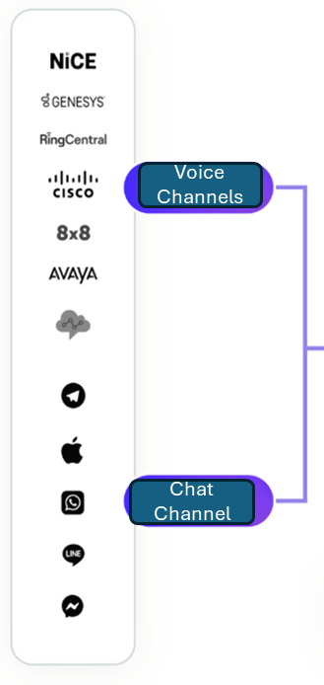
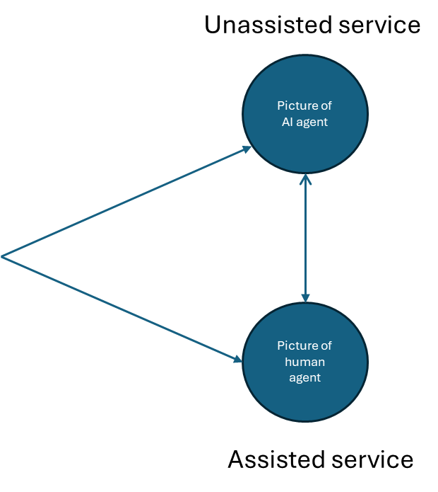
Platform – Channels
Trusted conversations, no matter the channel
Trust Orchestrator is designed to make voice and chat conversations across multiple interfaces flow seamlessly.
Unassisted Voice
Unassisted Chat
Agent Assist

Slide 30
Platform – Channels – Unassisted Voice
Match conversational fluency with control
Allow customers to talk naturally while being skillfully guided through the conversation, ensuring their goal gets achieved in line with your enterprise’s rules, process and systems
Unassisted service
Human-like fluency
Picture of AI agent
Natural voice conversations across languages that adapt to sudden changes in direction, sentiment or context
Analyses, diagnoses, resolves, actions
Expert-level engagements
Conversational IVR
Move beyond simple assistant-level responses to ensure goals get clarified, situations and needs effectively analysed and root causes identified before responses offered.
Picture of AI Agent
Transfer
Transfers with context
Picture of human agent
Where requested or required, calls get transferred with full context to ensure seamless continuation of the engagement journey no matter the channel
Answers, clarifies, responds, routes
Analyses, diagnoses, resolves, actions
Full auditability
Every question asked, answer given, action triggered and rule applied gets tracked for reporting and insights
Assisted service

Slide 31
Platform – Channels – Unassisted Voice
Increase your unassisted voice automation volumes
Trust Orchestrator is designed to increase the number of calls that get fully automated, without relying on humans in the loop
Effective upfront clarification
Smiling agent/customer picture
The customer’s intent(s) and goal(s) are clarified to the required level before being passed to the right agent for next action
Improved context understanding
Prior to offering a response or next action, the situation, need and/or root cause is analysed in detail to ensure full context is considered
Agile response to change
If the customer changes the conversation direction or shifts sentiment, the Conversational AI Agent adjusts while staying firmly on your guardrails.
Trusted responses and next actions
By the time a next action gets triggered or a response is sought, full context is gathered. This ensures that more fully automated engagements can be supported with trust.

Slide 32
Platform – Channels - Unassisted Voice
Always available, 24/7
Transform your total customer experience
Personalises each call
When speaking to a Conversational AI Agent powered by Trust Orchestrator, it feels like you are talking to a human expert. Someone capable of listening, asking questions and getting the job done, first time.
Have a listen for yourself.
Clarifies multi-intents and goals
Speaks in multiple languages
Handles caller authentication
Analyses, diagnoses, resolves
Demo video
Asks questions before giving answers
Adjusts to changing sentiment
Identifies opportunities for cross sale
Transitions across channels
Transfers with full context
Gathers required data and feedback
See voice use cases
Provides full call tracking

Slide 33
Platform – Channels – Unassisted Chat
Improve unassisted chat automation volumes
Most chat (text) services rely on ‘live’ (human) agents to take over as soon as conversations get complex or context-rich. The menu-driven conversation flows simply can’t cope. With Trust Orchestrator, you can dramatically increase the number of chat conversations that get resolved entirely unassisted.
Video demo
Natural conversations without the restrictions
Free flowing conversations (not menu driven)
Expert level engagements (not just FAQs)
Trusted data gathering and provision
One touch resolution (no waiting for live chat)
Watch Now
Automate more chat conversations without relying on live agents

Slide 34
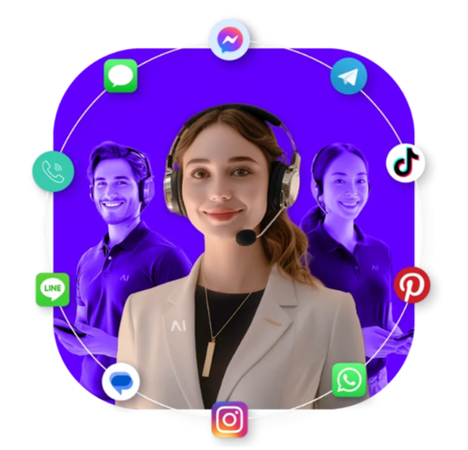
Platform – Channels – Unassisted Chat
Unlock the true power of text-based communication
Trust Orchestrator powers natural chat conversations that resolve both simple to complex queries and requests.
Make one touch resolution standard.
Inbound query resolution
Automate more queries by ensuring a better understanding of the goal, situation, need and/or root cause before offering a solution
Outbound sales and service
Trigger in-context outbound conversations for proactive servicing and/or cross and up-sale conversations
Effective data collection
Gather outstanding information required to process the agreed next action e.g. documentation, images, details
Authentication and authorization
Send an OTP, provide required terms and conditions, and get customer approvals to proceed with specific actions
See chat use cases

Slide 35
Platform – Channels – Agent Assist
Transition your staff to higher value calls
Picture of a driver with a GPS
Trust Orchestrator’s role is to maximise conversation automation. It does this by offering Conversational AI Agents capable of automating complex rule-bound calls without human intervention.
While these Conversational AI Agents get upskilled to handle the full range of rule-bound call types, human agents need the space to develop the skills required to handle more complex, emotion-laden conversations. This is difficult if they keep answering rule-bound calls.
To make the transition easier, Trust Orchestrator offers a Call Navigator. This allows human agents to navigate rule-bound calls without first having to learn them. It means they can step in whenever a customer prefers to speak to a human, while focusing on learning to handle the call types they can make a real difference to. The ones that are less rule-bound and require more EQ.
Book a demo

Slide 36
Platform – Channels – Agent Assist
Real time navigation through complex, context-rich conversations
As the call comes through, the Call Navigator immediately offers the human agent scripted guidance on what to say and what to do, in context of the caller and intent. It can also answer any question related to product, policy or process.
Contextually adaptive
Video demo
Based on responses and 3rd party data, the script can adjust to reflect the call’s context
Automatic compliance
Dynamically applies process and policy guardrails that adapt to context yet ensure required data is collected in the right format for correct next actions
Instant support
At any point in the conversation, human agents can access expert-level support to respond to a sudden and unexpected question, in context
Watch Now
Full reporting
No need for post call wrap ups. The full call script is tracked and available for reporting and insights
Reduce training by as much as 40%
Improve FCR to >95%
Improve QA scores to 100%
Notes:
5% not that much – can it be better?? Or is that significant?

Slide 37
Platform – Modules
Trust Orchestrator consists of 3 modules that work in concert to orchestrate high volumes of sales, service and support conversations across multiple channels and systems, in line with business and regulatory rules.
Trust Studio
Trust Engine
Trust Manager
Trust Studio allows low/no code teams to define the rules of the conversational guardrails for targeted conversations
Trust Engine applies the rules in context to each conversation and orchestrates the correct next response or action
Trust Manager controls the rules for access rights, global settings, reporting and logic maintenance
Learn More
Learn More
Learn More
Engineer trust into every conversation

Slide 38
Platform – Modules – Trust Studio
Architect trusted conversations
Image with key features
Trust Studio allows no/low code authors to architect the guardrails that control the conversational pathways of assisted and unassisted conversations.
These guardrails are formed by data-driven logic objects that contain specific conversational rules.
Trust Studio makes it easy to capture these rules with context. Targeted conversation flows are crafted by connecting logic objects in sequence. Each flow can reflect thousands of possible pathways, based on combinations of data applied.
The ability to create and re-use logic objects across conversational flows makes it possible to control hundreds of call flows with millions of possible pathways centrally.

Slide 39
Platform – Modules – Trust Engine
Powering conversations in context
Image with key features
While the Trust Studio defines the conversational rules (Build), Trust Engine carries them out in production (Run).
Leveraging rich APIs and connectors, Trust Engine gathers the required contextual data (customer data from a CRM, intent and sentiment data from an LLM and/or response data from the customer) and compiles the required instruction for the appropriate next response or action.

Slide 40
Platform – Modules – Trust Manager
Controlling conversations at scale
Image with key features
Trust Manager is the overall control centre. It lets you to set higher level engagement rules, including authoring, interface and system access. It allows you to manage logic versions across accounts, and to set the data export rules and schedules for reporting.
Control is central to the design of Trust Orchestrator, and Trust Manager ensures you always have control of who can update different conversational logic rules, who can communicate with different AI Agents, what global rules should be applied to these engagements and what reporting should look like.

Slide 41
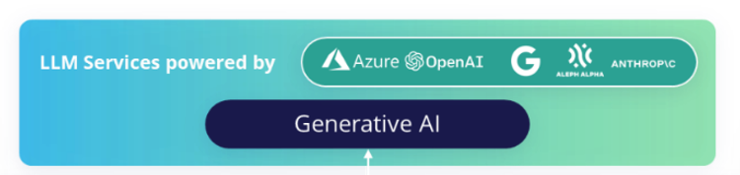
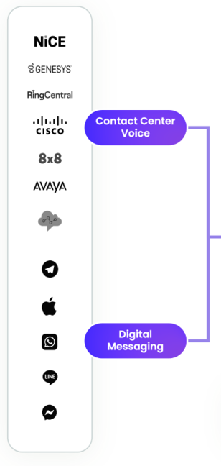
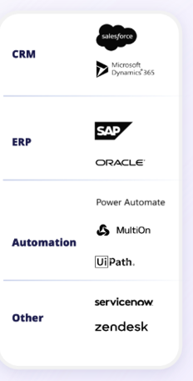
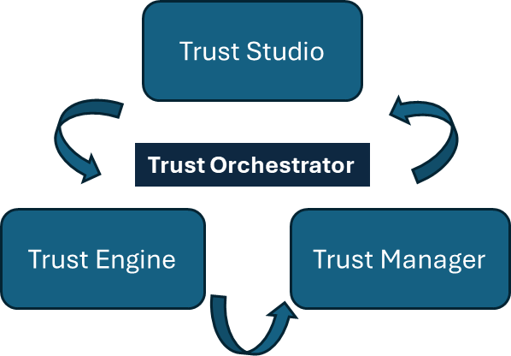
Platform – Architecture
Trust Orchestrator works within existing CX stacks
Trust Orchestrator is designed to be agnostic of channel and system. Its role is to control the flow of every conversation across channels and systems, while keeping a detailed record of everything that is said or done.
Business Systems
Cognitive Services
Voice Channels
Chat Channel
Reporting and Analytics

Slide 42
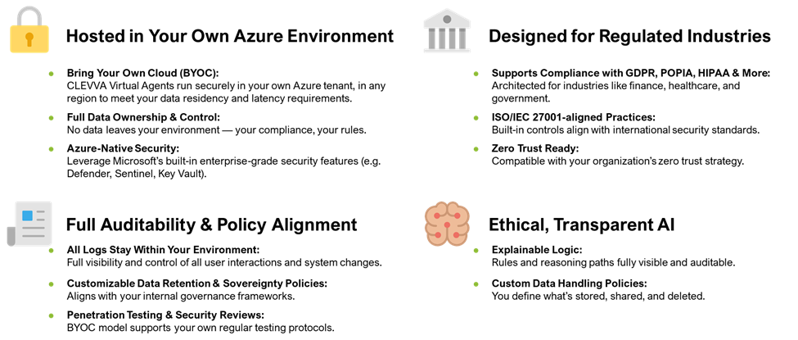
Platform – Architecture – Security and Compliance
Trust Orchestrator is designed with security and compliance top of mind.

Slide 43
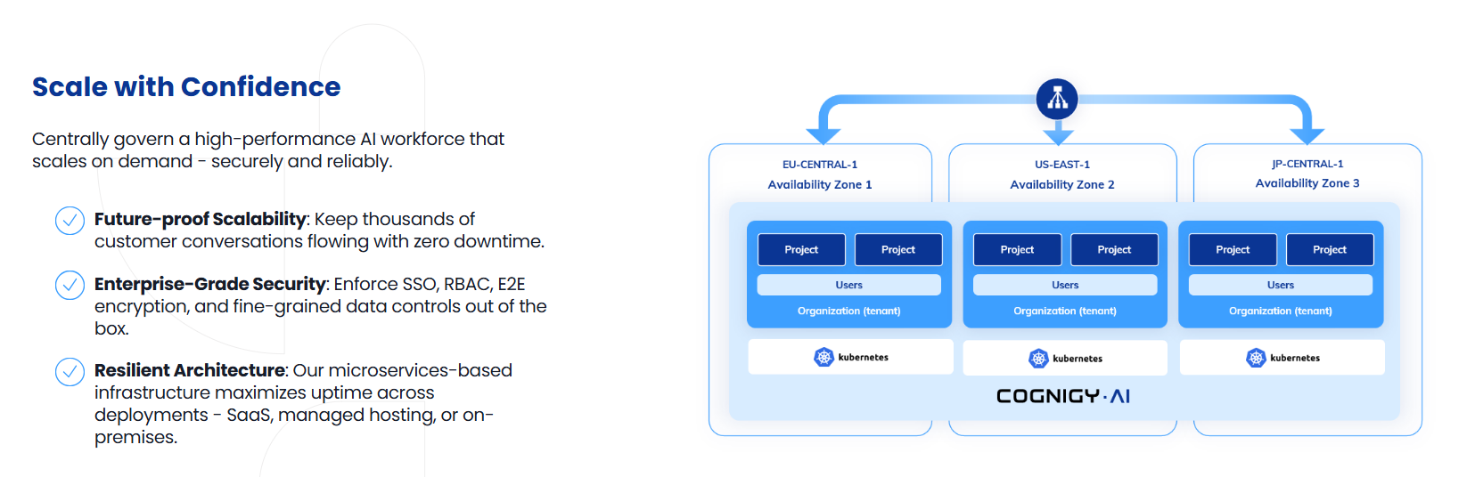
Platform – Architecture – Hosting
Mark please update to align with our approach
Trust Orchestrator

Slide 44
Use Cases
Unassisted Voice
Unassisted Chat
Agent Assist

Slide 45
Use cases – for each one
Possibly have a mini landing page that explains the channel e.g.
AI Agents automating real-time voice calls and resolving complex queries without requiring a human agent in the loop.
Then like with CLEVVAs Resources/Examples, have a filter to view use case videos and written use cases (pdf’s) of:
Industry
Financial sector
Telecoms
Public Sector
Healthcare
Travel and hospitality
Media
Video
PDF
Filters – dynamic (so if nothing, don’t show)

Slide 46
Resources
Blog
Documentation
Academy

Slide 47
Resources – Blog
Similar to CLEVVA’s in the press?

Slide 48
Resources – Documentation
Can we make this page offer different links to different support documentation that our team decide to add as they go?

Slide 49
Resources – Academy
Get certified to work with Trust Orchestrator
Image
The Trust Academy is designed to help aspiring Trust Engineers learn the art and craft of trusted conversational automation.
Offering a combination of self-learning modules, templates and real-time support, low/no code individuals can get themselves certified as Trust Engineers.
To apply, click here

Slide 50
Company
About
Executive Team
Values
Partners
Notes:
I think your intro has already given the pain point and the solutions – can you consider this being a ‘Solutions we offer’ or “Options we offer’ page?

Slide 51
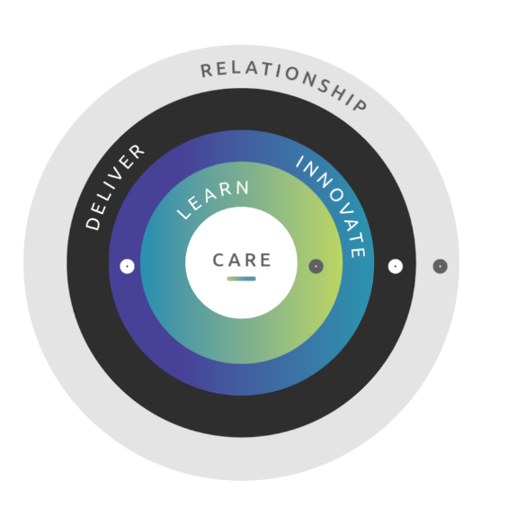
Company
Company
Trust Orchestrator is owned by RD MAK, a private company that specializes in intelligent automation technologies. RD MAK is based in London, United Kingdom.
Executive Team
Dayne Falkenberg: CEO
Paul Pedersen: Head of Software Development
Mark Pedersen: Head of Sales and Partner Support
Maryke Snyman: Head of Operations
Values
We are a value-centred company that puts care at our centre. Care for ourselves, our team, our company, our clients and our environment. This sense of care allows us to learn constantly, to innovate feverishly, to deliver on our promises and in so doing to build long term and healthy relationships with everyone we interact with.
Partners
We are proud to work closely with a team of trusted resellers and implementation partners. They include:
CLEVVA
OAS

Slide 52
Contact us
To arrange a demo or to be introduced to a partner, complete the following:
Same as CLEVVA – form?

